Slide 1
Decision Trees
Garbarino Giacomo
S4545532
University of Genoa

Slide 2
Why decision trees?
Simulate human decision-making.
Help to think about all possible outcomes of a problem.
Same approach of flowchart diagrams.

Slide 3
What does a decision tree consist of?
Supervised learning algorithm.
Mostly for classification problem.
Defines all possible solutions of a problem based on decisions.

Slide 4


What does a decision tree consist of?
Tree-structured algorithm.
Root node, decision nodes and leaf nodes.
Construction of the tree based on two equivalent metrics:
Information gain:
Gini index:

Slide 5
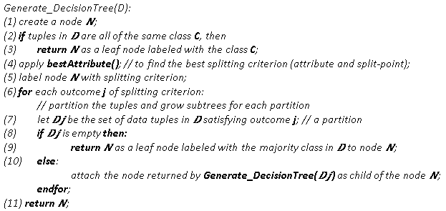
Decision Tree Algorithm

Slide 6
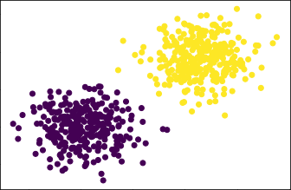
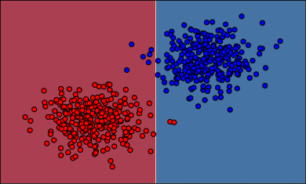
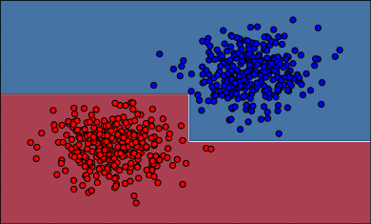
Example of Execution

Slide 7
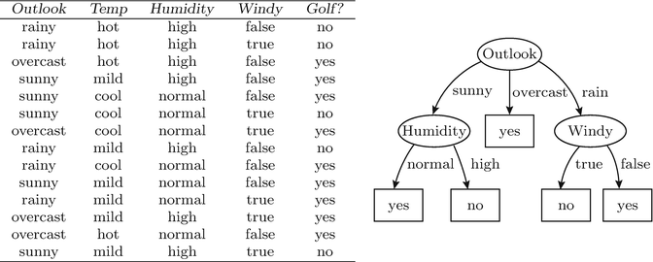
Example of a Decision Tree

Slide 8
Overfitting and Pruning
Decision trees tend to overfit easily.
Pruning is a good way to avoid overfitting.
Post-pruning is the most common approach.

Slide 9
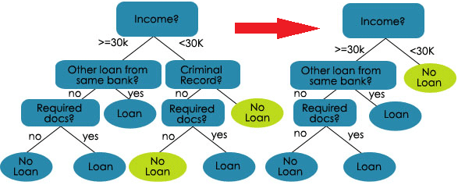
Example of Post-Pruning

Slide 10
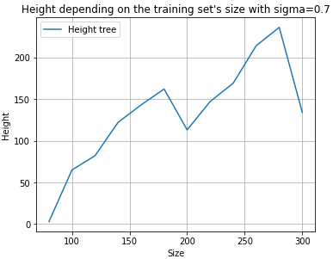
Assessment and Conclusions
Height is directly proportional to the size of the training set.

Slide 11
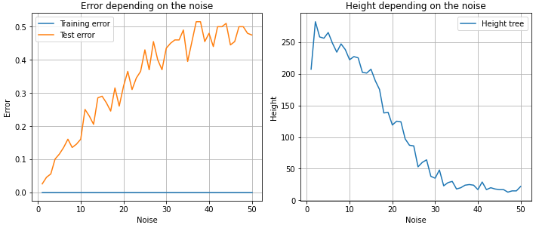
Assessment and Conclusions
Height is inversely proportional to the noise.
Higher noise, higher overfitting.

Slide 12
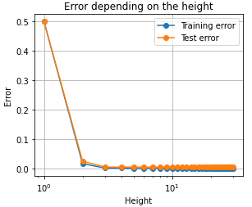
Assessment and Conclusions
With the increasing of the height, errors decrease.

Slide 13
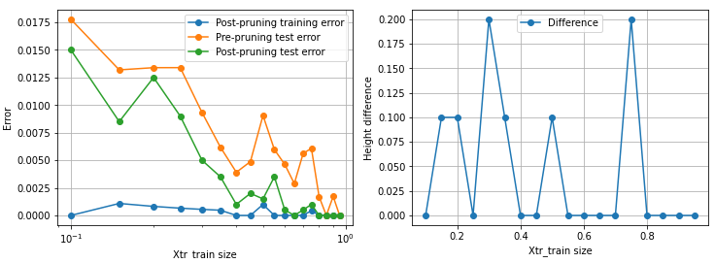
Assessment and Conclusions
Post-pruning shows better results in the case of very large datasets.

Slide 14
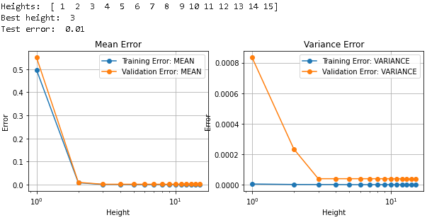
Assessment and Conclusions
K-Fold cross-validation procedure can return a very low height with very low errors.

